Slide 1
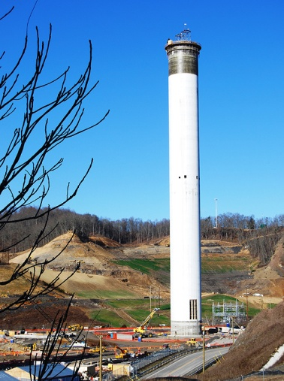
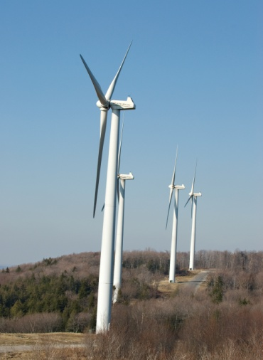
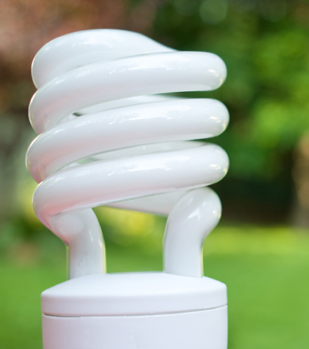

Dominion:
New Directions in Energy
Notes:
Good morning. My name is Bill Murray and I’m here to talk to you today about your electric utility, Dominion, and some of the issues we are working on.

Slide 2
About Dominion: Diverse Generation Mix
Dominion Virginia Power
Notes:
I’d like to start by talking about one of Dominion’s strengths, fuel diversity. That’s a fancy way of saying we don’t put all our eggs in one basket. We have a balanced mix of nuclear, fossil fuels, and renewable energy. Nuclear power is one of our great strengths, it’s only 18 percent of our system capacity but it is 41 percent of what we generate, because our nuclear stations run almost all the time. We are one of the best, we like to think the best nuclear operators in the United States with two units in Surry County and two at North Anna in Louisa County. We also have a growing amount of natural gas and renewable capability.

Slide 3
About Dominion: Low Carbon Intensity
100 Largest U.S. Power Producers
(Pounds CO₂ per MWh Output)
Dominion
Source: Natural Resources Defense Council, 2008 Study
Notes:
According to the Natural Resources Defense Council (NRDC), Dominion is in the best third of all U.S. electric utilities in minimizing carbon intensity. The NRDC’s 2008 report found that the company produced 1,101.6 pounds of carbon dioxide per megawatt-hour of electricity in 2006 compared with 1,615.7 pounds for the median of the nation’s 100 largest electric power producers. This is like golf, you want a low score. We do well here because of our strong nuclear presence. Do you know how much carbon a nuclear station emits (answer, none).
From 2000 to 2007, Dominion reduced its carbon intensity, or carbon emissions per megawatt hour, by 15%. CO2 intensity for the Dominion fleet has declined over this period primarily due to the acquisition and build of lower emitting generation and acquisition of non-greenhouse gas emitting nuclear generation, as well as changes in demand for some units.

Slide 4











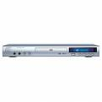








Our list of must-haves grows
The typical homeowner has increased electricity use by 8.6 percent since 1992
Energy Use
1970
1980
1990
2000
2010
Notes:
We like new products. Many of the new technologies we enjoy – and consider must-have parts of our daily lives – rely on electricity to operate.
As the chart symbolizes, over the decades there has been a growing demand for electricity as technology advances. Since Dominion Virginia Power’s last rate increase in 1992, the typical homeowner has increased electricity use by 8.6 percent.
A large-screen television, for example, uses five times as much power as older models. Home electronics now account for 11 to 13 percent of consumer energy use and are projected to account for 18 percent by 2015, according to the Environmental Protection Agency. And by 2015, who knows what we’ll be carrying in our pockets and purses?

Slide 5
Demand is up in Virginia
Residential demand is up by 61 percent since 1990
Notes:
Here in Virginia, as in the United States, demand has grown substantially – up 60 percent among residential customers in Virginia since 1990. There are many reasons.
Virginians have been building larger homes and equipping them with more electronics. Plus, Dominion Virginia Power has added more than 500,000 customers since our last base rate case in 1992. In other words, many more people are using much more electricity.

Slide 6
The upcoming gap
Megawatts (MW)
22,000
20,000
4,600 MW
by 2019
The “gap”
18,000
16,000
2007
2019
Existing generating capacity
Source: PJM long-range forecast, January 2009
Expected peak demand
Notes:
… because demand is not going to let up. PJM, which manages the regional transmission grid, estimates that by 2019, Dominion Virginia Power’s service area will require an additional 4,600 megawatts of capacity, or enough power for more than one million new homes.
We expect to hook up about 30,000 new customers a year this year and into the future. Some of those customers are data centers in Northern Virginia that process Internet traffic.
Half the world’s Internet traffic goes through these data centers in Northern Virginia, and new centers are being planned in other parts of the state, as well. They use a lot more electricity than the typical office building.

Slide 7
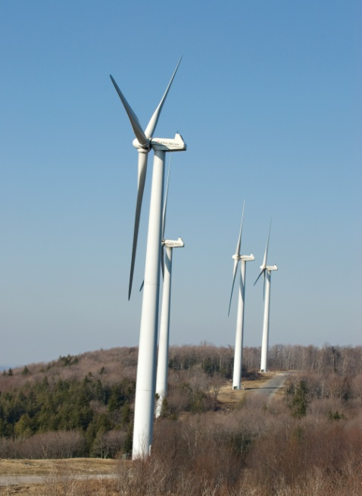

Dominion’s Integrated Strategy
Integrated resource plan filing in September 2009
Based on AARP legislation from 2008
15 year planning horizon
Intensified conservation programs
Environmentally friendly generation, including renewable, clean coal, natural gas, possible nuclear
Transmission and delivery system improvements, “smart meters”
Notes:
We have a strategy to close the gap with three tools: conservation, new generation, and transmission and delivery improvements. I’m going to talk briefly about each of these.

Slide 8
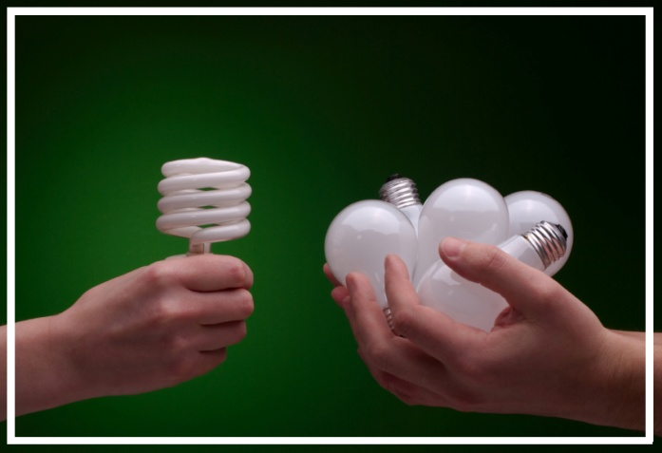
Dominion’s Response:
Conservation
Conservation a key to meeting Virginia’s growing energy needs while protecting the environment.
Distributed approximately 4 million CFL light bulbs.
Conservation Plan filed with SCC July 28
Projected to save customers $1.2 billion over 15 years.
Smart meters key part of the plan.
Homeowner incentives to:
Tune up heat pumps
Install energy-efficient heat pumps
Turn in old refrigerators
Cycle off air conditioners during peak periods
Notes:
Conservation is a major priority for our company. On Earth Day this year we announced that we had distributed our three millionth compact florescent light bulb as part of our partnership with Home Depot. We will be filing our comprehensive conservation plan with our state regulators in July. This plan is expected to save customers about $1 billion over 15 years by installing smart meters in every home and by implementing a series of other programs I’ll describe on the next slides. Conservation is a critical element of our integrated strategy.

Slide 9
Smart meters
Two-way
communications
Voltage Conservation
Improved outage
reporting and repair
Notes:
Smart meters are the way of the future. With Smart Meters, you will have more information in your hands about how you use power, for what and when. This will enable all of us to manage our energy use without compromising power needs.
Smart meters can communicate electronically back and forth with the company. This will enable us to identify areas of outages and other problems in the system quicker. The system can run more efficiently and at lower cost.
Initially, we have installed a small number of smart meters in the Richmond suburb of Midlothian and will install 47,000 in the Charlottesville area by the end of the year to test their performance. We expect to invest about $600 million to replace all our existing electric meters with smart meters by 2014.

Slide 10

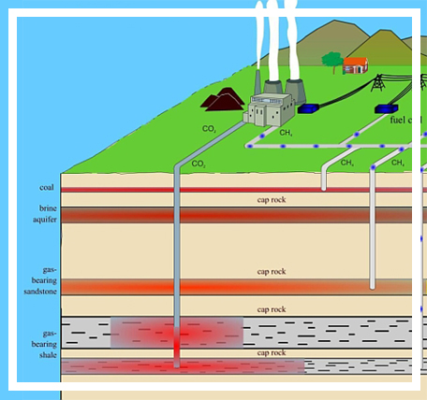
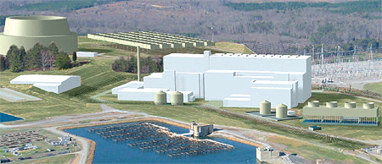
Dominion’s Response:
Environmentally Friendly Generation
Possible North Anna 3 nuclear unit
New gas-powered generation
Unit uprates
Virginia City Hybrid Energy Center
Wind projects in Virginia, West Virginia, Illinois, and Indiana
Notes:
What are we investing our resources in? One major source of investment is new generation. We’re actively exploring a third nuclear unit at our North Anna power station, subject to the ability to responsibly finance this project which will be emissions free but expensive. We’ve received approval for new gas powered units in Buckingham County and Caroline County. And we’ve completed uprates at many of our existing stations, making them run more efficiently to generate more power.
We’ve also begun construction of our Hybrid Energy Center in Southwest Virginia and are developing several wind projects. I’d like to talk to you about those in more detail.

Slide 11
Dominion’s Renewable Assets: Utility-Owned Generation Portfolio
Utility-Owned Facilities – Operating Capacity
Pittsylvania – Virginia--Biomass 83 MW
Altavista – Virginia--Biomass 6 MW
Gaston – North Carolina--Hyrdo 220 MW
Roanoke Rapids – North Carolina--Hydro 95 MW
Cushaw – Virginia--Hydro 2 MW
North Anna – Virginia--Hydro 1 MW
Utility-Owned Facilities – Operating Total 407 MW
Utility-Owned Facilities – In Development (announced)
Virginia City Hybrid Energy Center * – Virginia--Biomass 117 MW
Various Sites – Wind Projects with BP** – Virginia--Wind 245 MW
Utility-Owned Facilities Total: 769 MW
* Represents up to 20% of proposed Virginia City Hybrid Energy Center 585 MW coal station
** Capacity shown as Dominion’s net share (projects are 50/50 partnerships)

Slide 12
Dominion’s Renewable Assets: Merchant Generation
Capacity
Merchant Renewable Facilities – Operating
NedPower Mount Storm Wind Farm** - West Virginia 132 MW
Fowler Ridge Wind Farm (Phase I)** - Indiana 150 MW
Merchant Renewable Facilities – In Development (announced)
Fowler Ridge Wind Farm (Phase IV) - Indiana 150 MW
Prairie Fork Wind Farm - Illinois 300 MW
Merchant Renewable Facilities 732 MW
TOTAL RENEWABLE FACILITIES: 1501 MW
** Capacity shown as Dominion’s net share (projects are 50/50 partnerships)

Slide 13
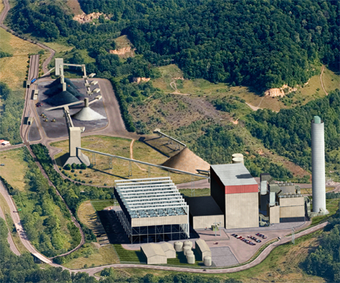
Virginia City Hybrid Energy Center
“What Dominion has proposed is the full up suite of controls. It is the best there is.” Bruce Buckheit, State Air Pollution Control Board member - June 25, 2008.
Project meets baseload energy needs and presents a strong environmental package.
Complete environmental package:
Protects air quality
Uses waste coal and carbon neutral biomass
Minimizes water use
Notes:
13

Slide 14
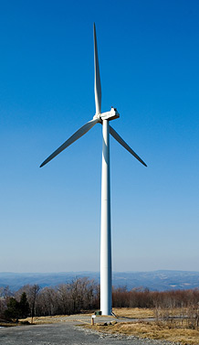
Dominion’s Operating and Proposed
Wind Energy Projects
NedPower in Mount Storm, WV:
264 megawatts (partnered with Shell)
Fowler Ridge in Benton County, IN:
- 400 megawatts online (partnered with BP)
- Could be expanded to total of 750 MW
Prairie Fork in Christian & Montgomery
Counties, IL:
300 megawatts
Virginia wind projects in Tazewell
and Wise Counties
Other projects in development in VA (not announced)
Notes:
Dominionis committed to meeting VA’s goal of 15 percent renewable power by 2025. Our renewable portfolio includes nearly 1,300 megawatts in development or operation. In West Virginia, we recently completed a wind farm with Shell WindEnergy Inc. In Indiana, we are working with BP Alternative Energy North America on that state’s largest wind energy project. The first phase went into commercial operation in early 2009. Dominion is also in the early stages of development for a wind project in Central Illinois. That project could produce 300 megawatts of clean electricity. We are also developing wind projects in Tazewell and Wise County Virginia, in partnership with British Petroleum.
Other renewable energy sources include:
Biomass at three Virginia power stations
- Pittsylvania Power Station
- Altavista Power Station
- Virginia City Hybrid Energy Center
Conventional and run-of-river hydroelectric
- Pumped storage helps make
renewable energy dispatchable

Slide 15
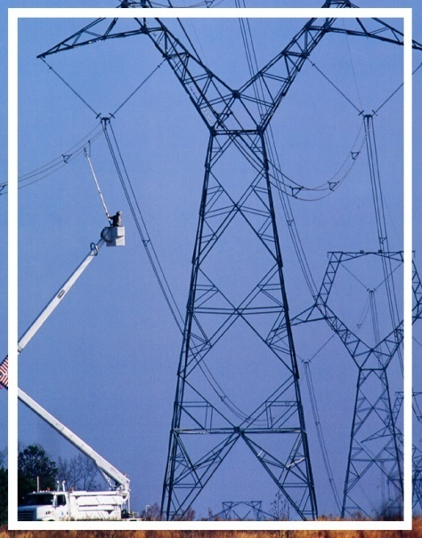
Transmission: Electricity's Highway System
Upgrading the Power Grid
Thirteen projects planned or
under way in Virginia and
North Carolina
Critical projects in Hampton
Roads, Central and
Northern Virginia
Power is useless unless you
can get it where it’s needed.
Notes:
Here’s one of the great challenges in the electricity business: Getting power from where it is generated to where it is needed. This is not a new problem, but a longstanding one. Building major new transmission lines invariably involves controversy and public resistance.
And, yet, power is useless unless you can get it where it’s needed.
When we talk about wind farms, for example, there are places in the U.S. where wind farms would be ideal – the upper Midwest, along the border with Canada. But there are no transmission lines available to move the electricity. That’s a problem that has to be resolved.
You encounter even more difficulty in highly developed areas, when new businesses expect the power to be there. The major Internet data centers in Northern Virginia, for instance, require huge amounts of power to be ready for them as they come online.
To meet that demand, generation is only one big step. Then you have to have the means to transmit it. That’s why upgrading the power grid in Virginia is so critical.
15

Slide 16


